Slide 1

ROBOT
For
CONTROLLING WILDFIRES
Shivam Joshi
Deep Trivedi
Yadukrishna BG
Advance Mechatronics
-Term Project-

Slide 2
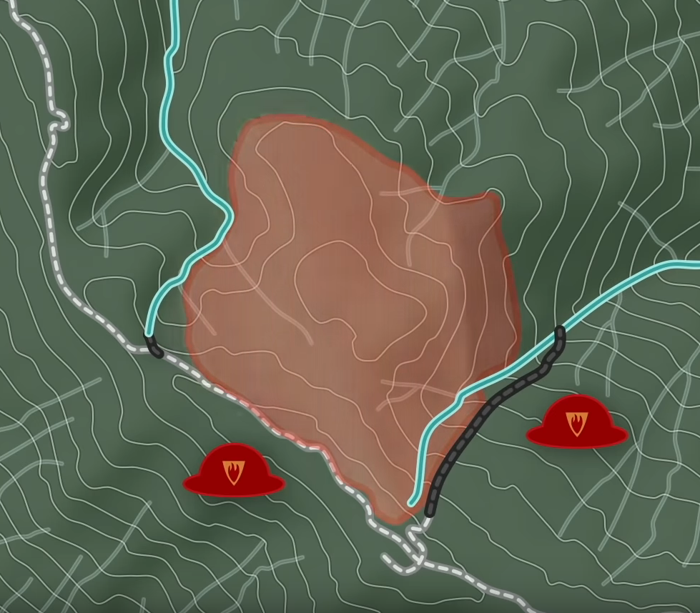



WHAT IS THE
DIFFERENCE ?
URBAN FIREFIGHTING
Clear APPROACH
Extinguishing METHODS
WILDLAND FIREFIGHTING
Gap in Research
Anchor Points | Firelines
FIRELINE
A Firebreak is a gap in vegetation or other combustible material that acts as a barrier to slow or stop the progress of a Wildfire.
Source: https://standard.tv/

Slide 3
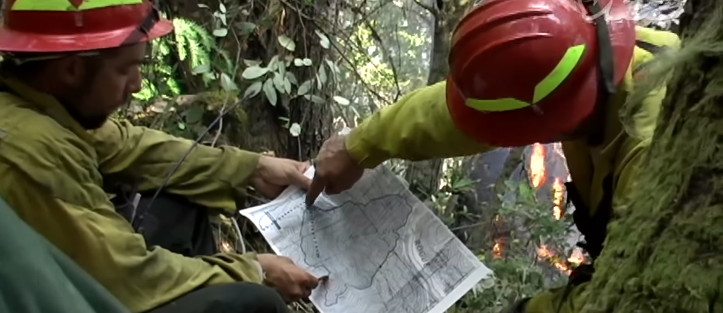
PROBLEM
We’re too slow and can not go too close to the fire.

Slide 4
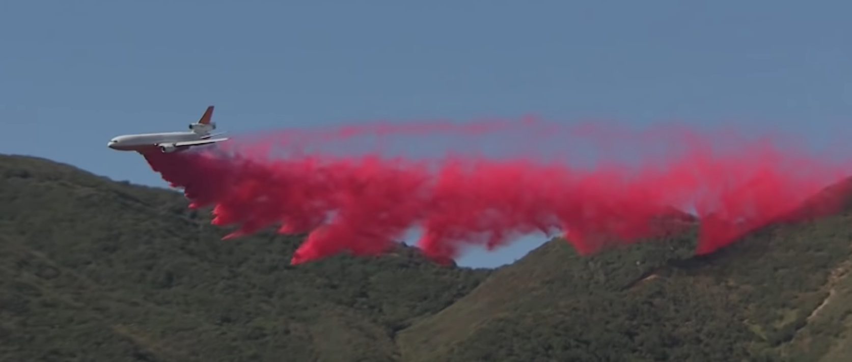
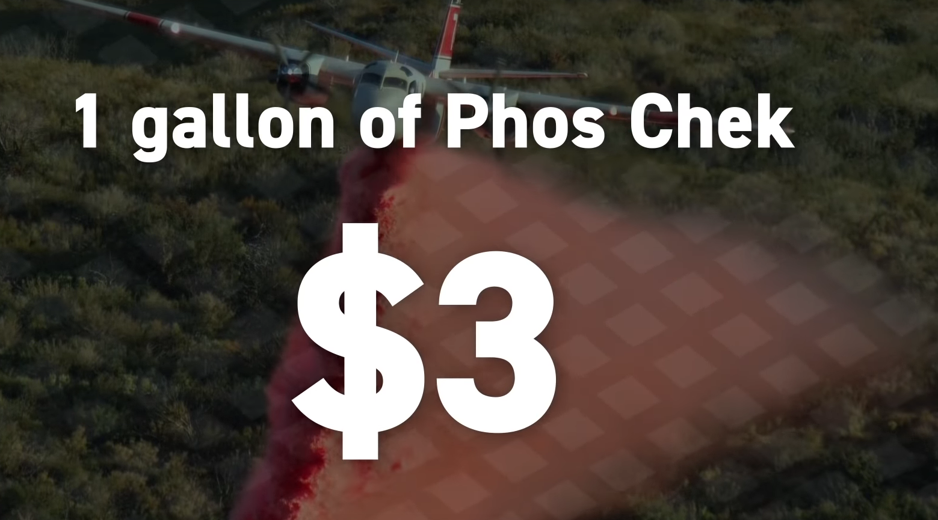
PROBLEM
They’re too Expensive
$60K = NYU Fees

Slide 5
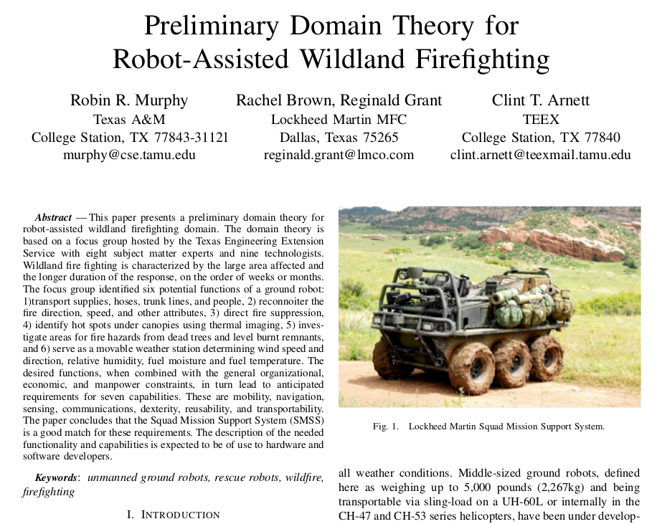
6 FUNCTIONS:
Hualing
Direct Fire Suppression
Mobile Weather Station
Reconnoiter
Hot Spot Identification
Investigate Fire Hazard Zone.
THIS PROJECT:
5. Hot Spot Identification
6. Investigate area

Slide 6
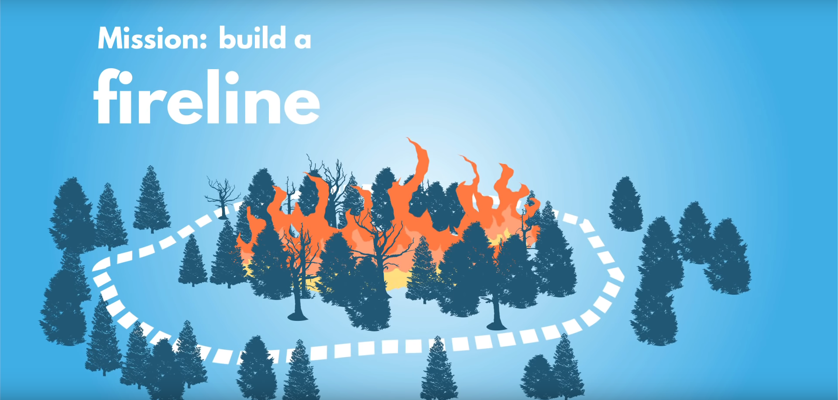
ROBOT, DO WHAT?

Slide 7


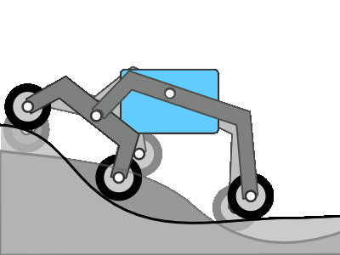
Mobile - Manipulator:
We created a manipulator which can be used to collect material in order to inspect, observe, or survey, and we aim to mount it on top of a mobile base with rocker-bogie which can be used to move through uneven conditions in wildland.
FUN FACT:
At the moment mobile manipulation is a subject of major focus in development and research environments, and mobile manipulators, are used in many areas. Source:https://en.wikipedia.org/wiki/Mobile_manipulator#State_of_the_art
FUN FACT:
The rocker-bogie system is NASA's favored design for rovers.
It has been used in multiple mission robots:
Sojourner, Spirit,
Opportunity, and Curiosity

Slide 8
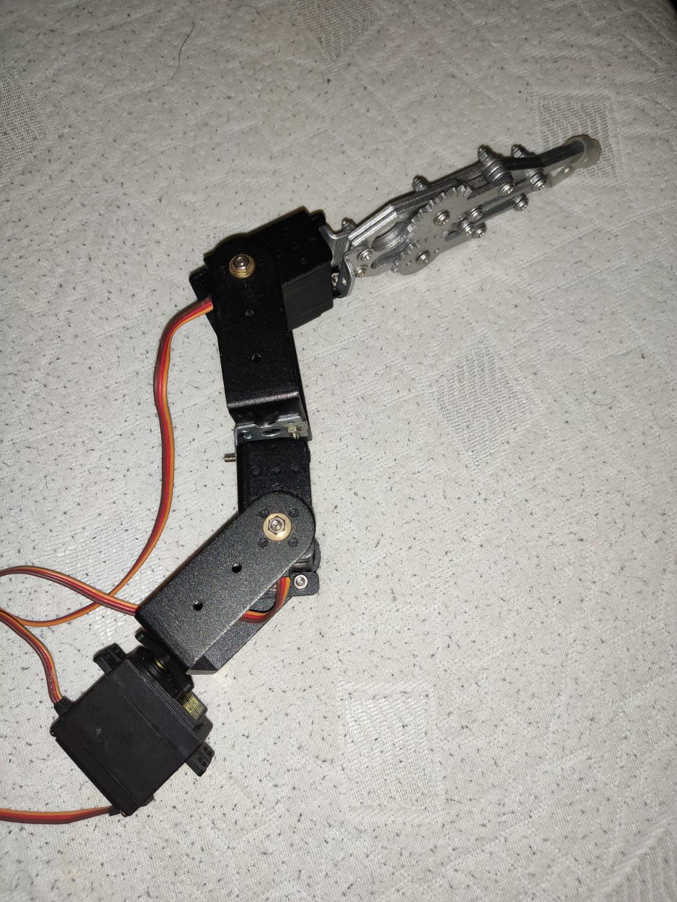
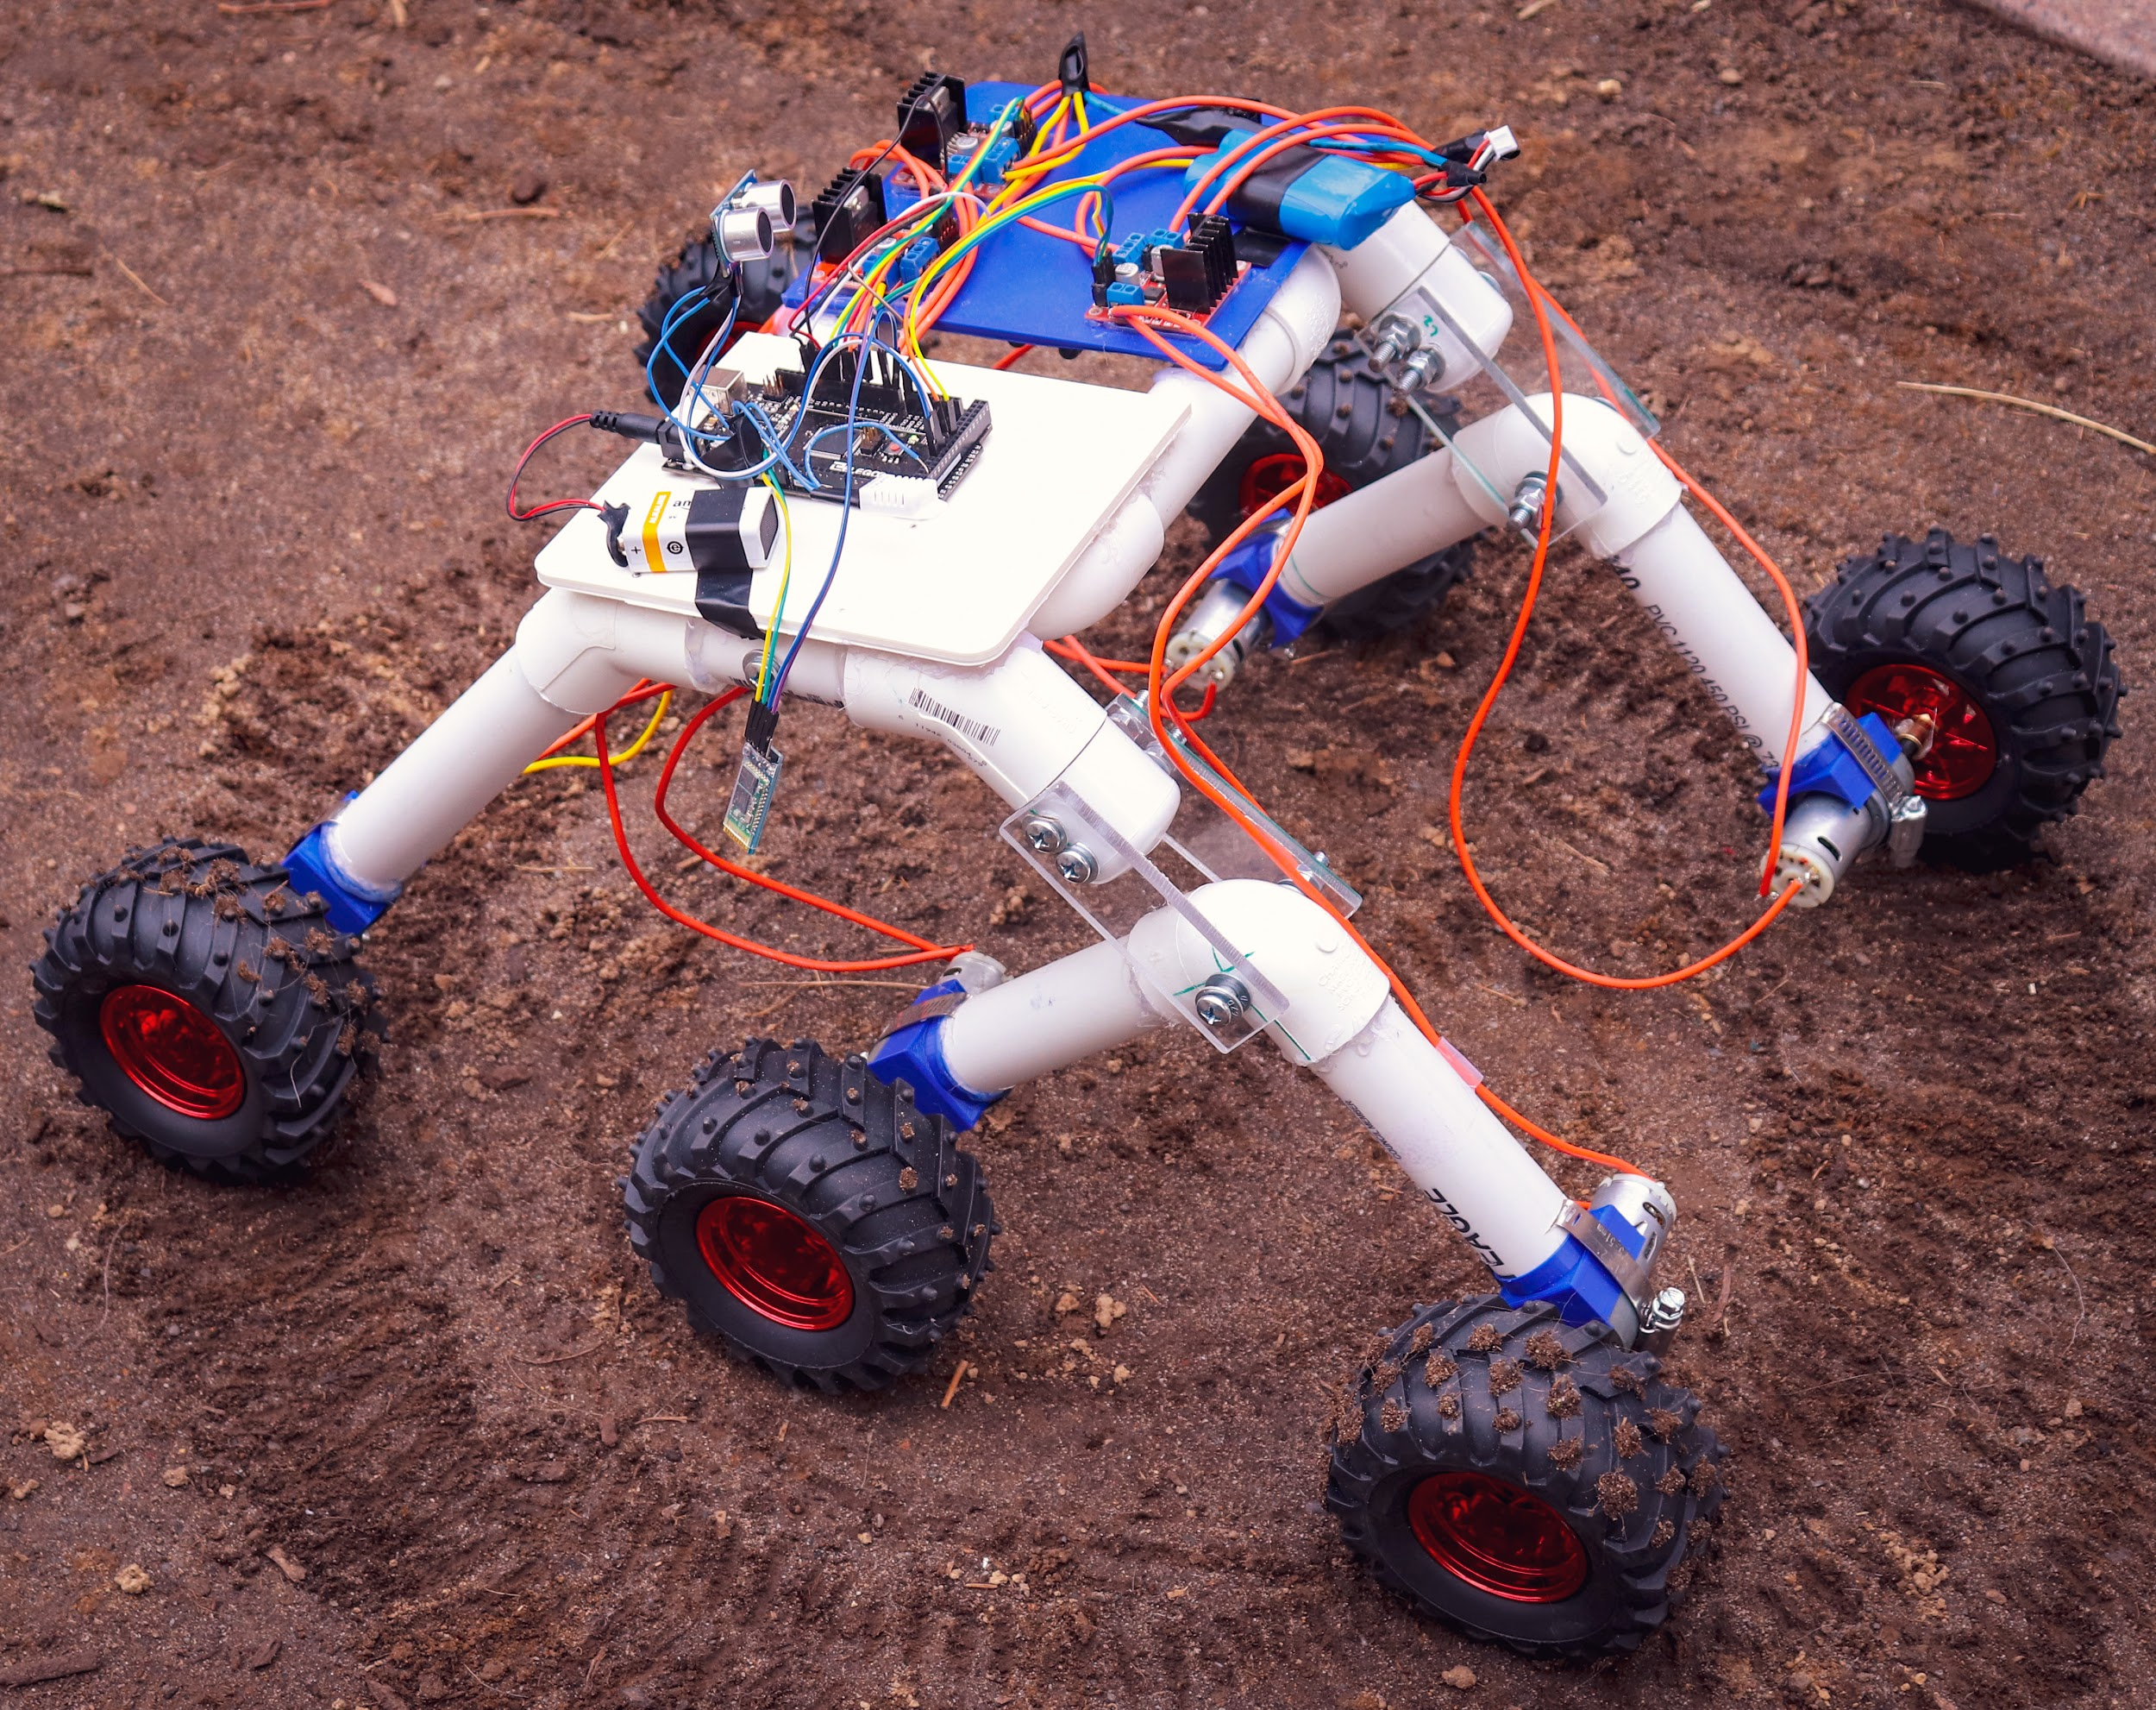
Manipulator
Mobile Base

Slide 9

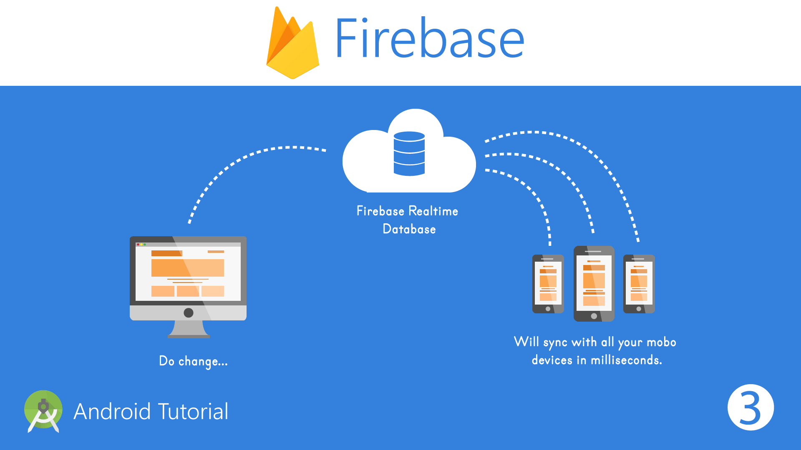

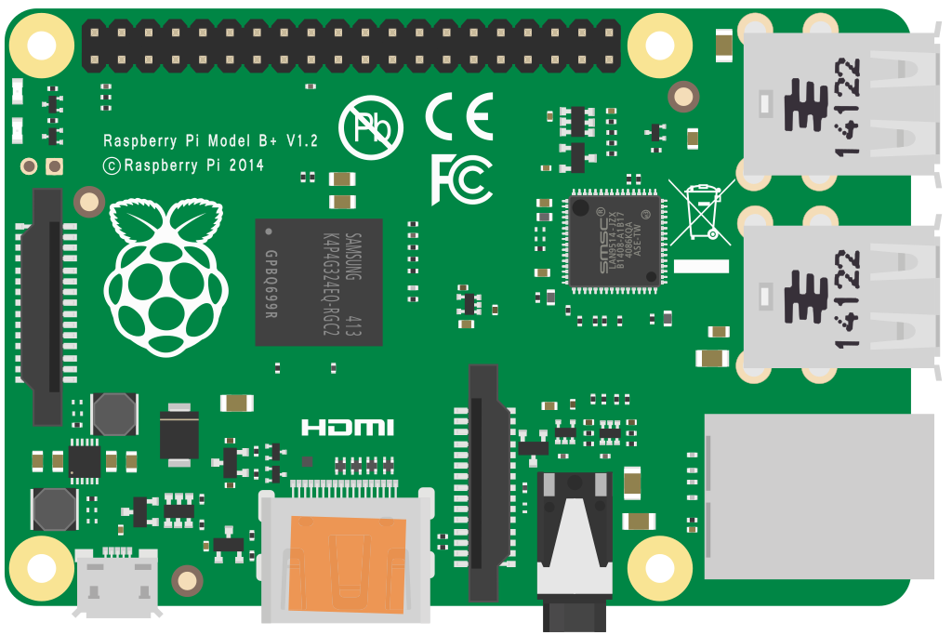
Serial COM

Slide 10
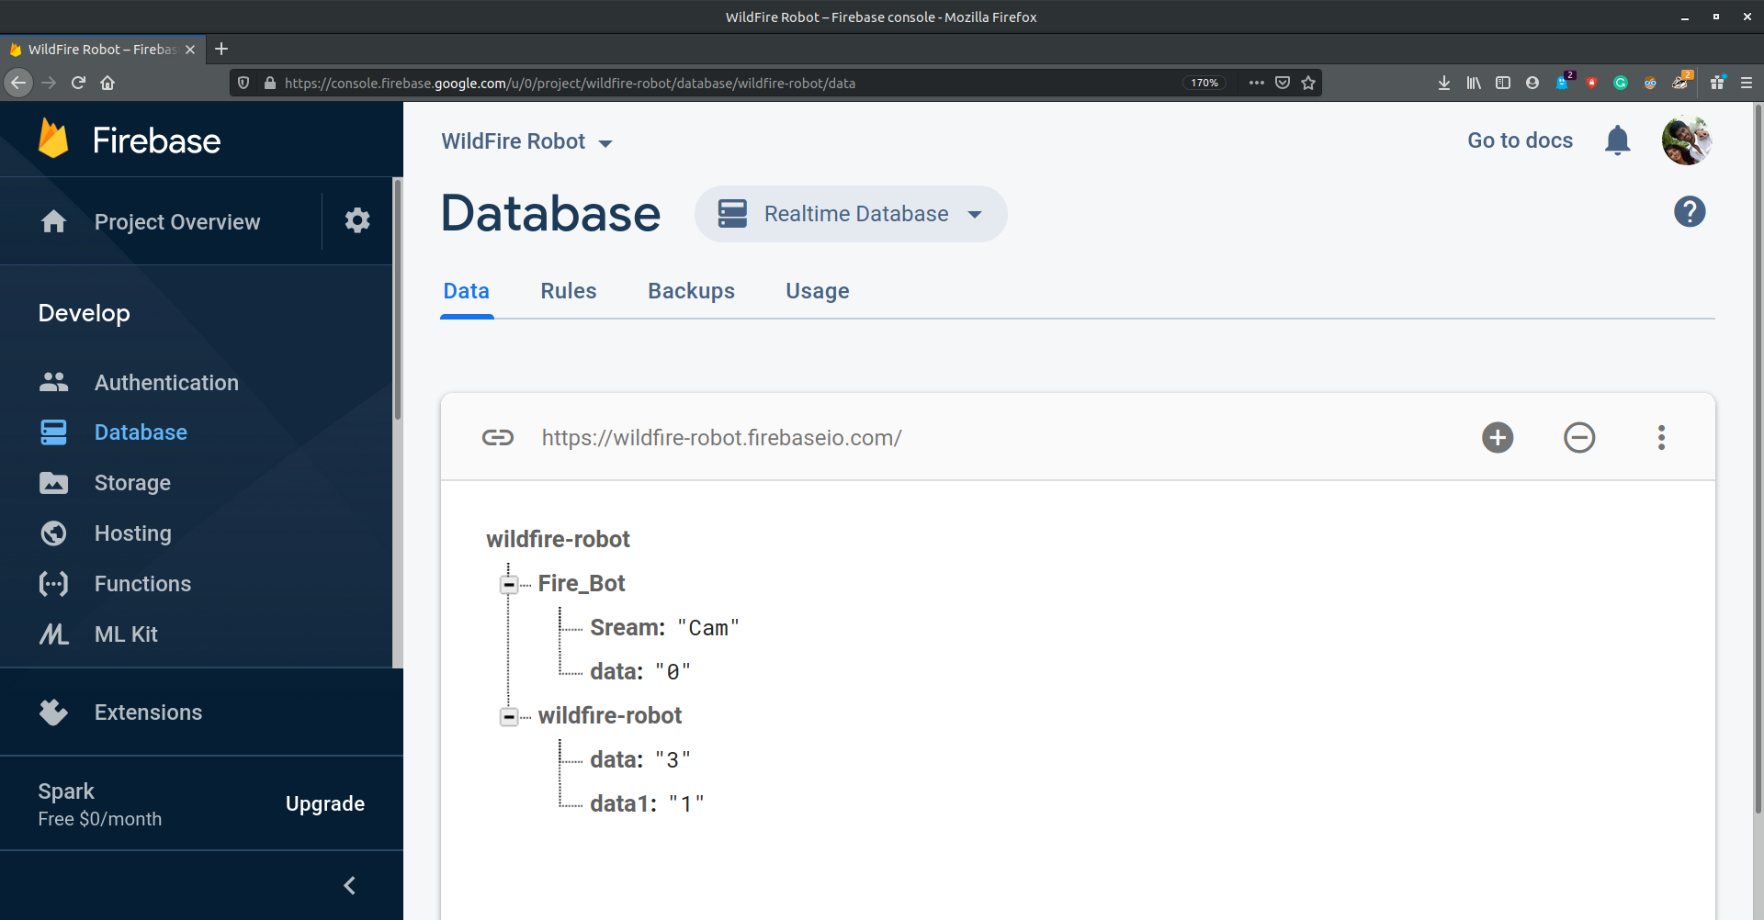

Slide 11
How ?
Hardware:
Raspberry Pi
Arduino Mega
Raspberry Pi Camera
1 Bluetooth Module (HC-05)
3 Motor driver (L298N)
Li-ion Battery (7.4V 1500mAh)
Humidity and Temperature
Sensor (DHT 22)
Ultrasonic Sensor (HC - SR04)
9V Alkaline Cell
Metal clamps for links
Metal Gripper
6 DC Motors
Thumper Wheels
Clamps, Hex Coupling, etc
Software:
MIT App Inventor - Link
Google Firebase - Link
RPi_Web_Interface - Link
Arduino IDE
Gedit on Raspbian
Raspbian Shell
(And with little help from our smart phone)

Slide 12
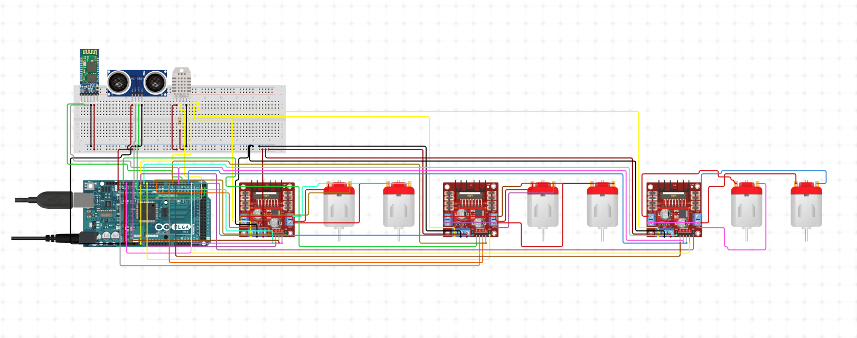
CIRCUIT DIAGRAM:

Slide 13
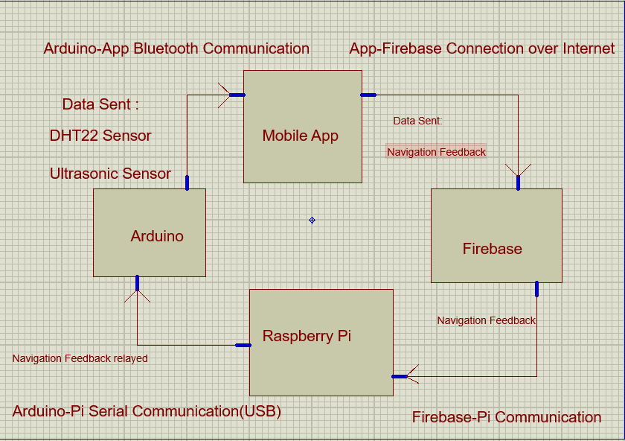

Slide 14
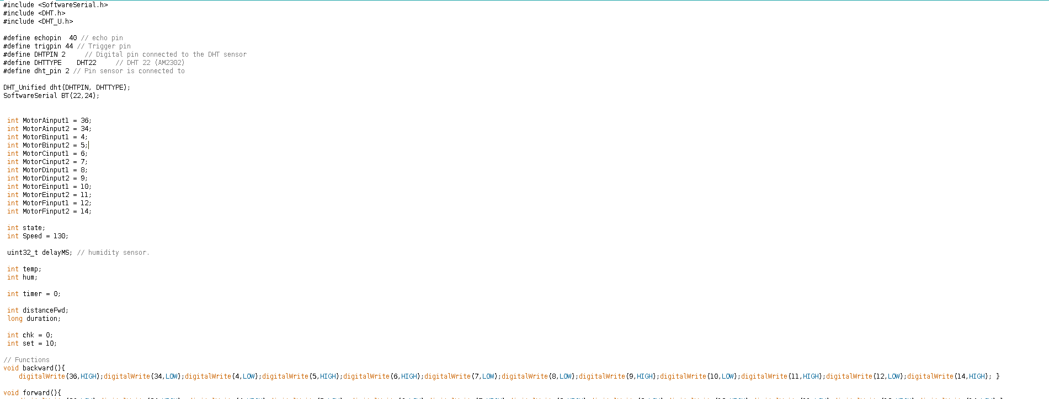
Code1: Arduino

Slide 15
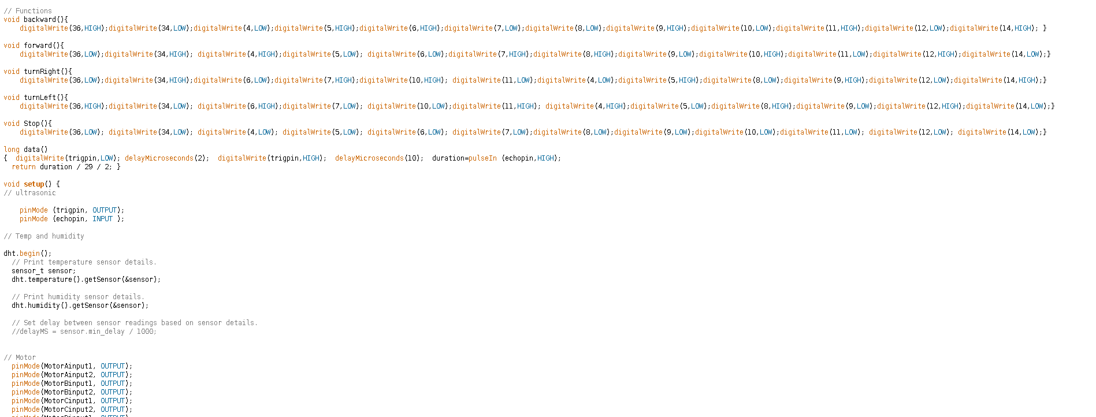
Code2: Arduino

Slide 16
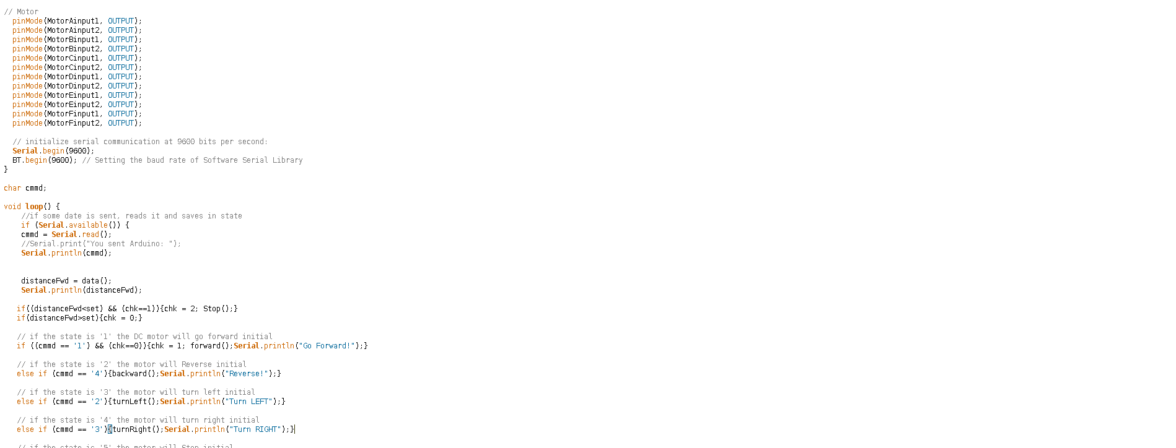
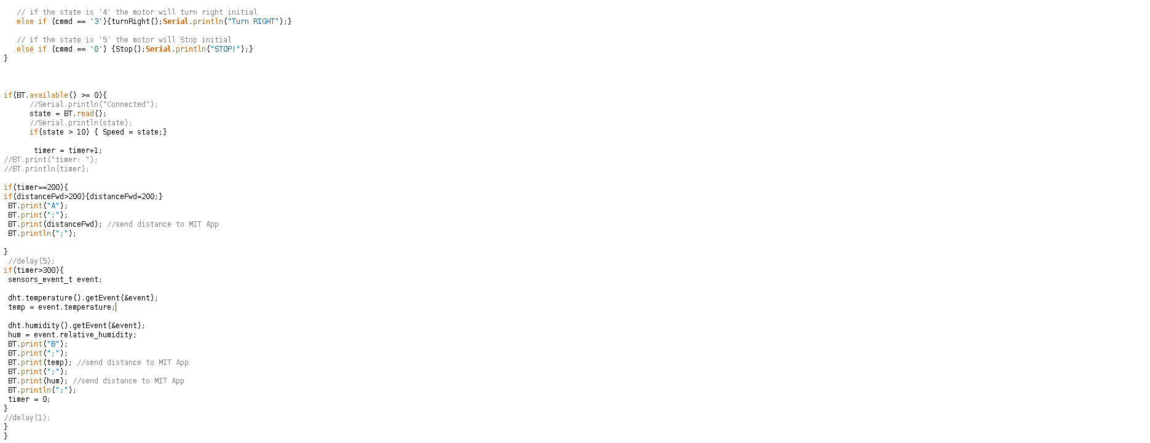
Code3: Arduino

Slide 17
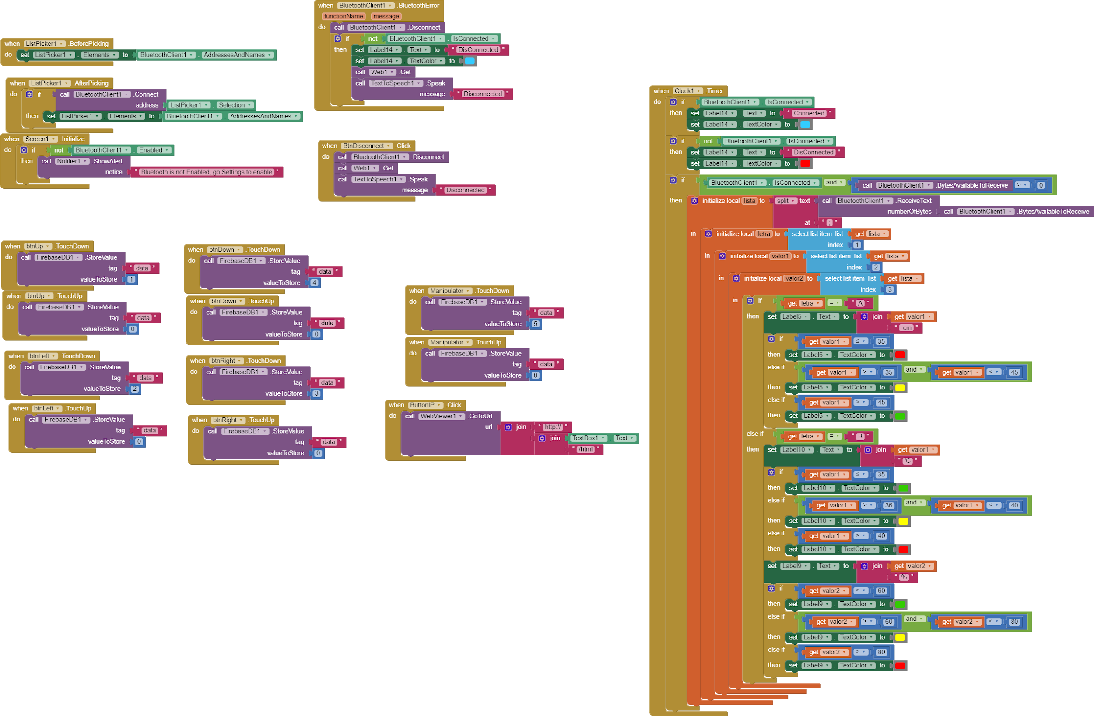
Code Blocks: App Inventor

Slide 18
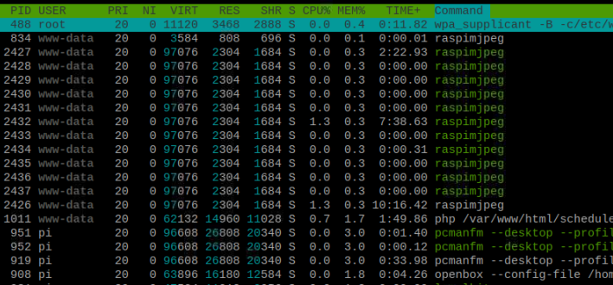
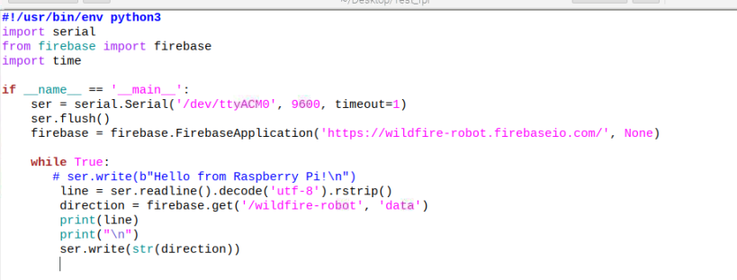
Code: Raspberry Pi
$ sudo apt-get python-firefox
$ git clone https://github.com/silvanmelchior/RPiCamWebInterface.git
$ cd RPi_Cam_Web_Interface
$ ./install.sh

Slide 19
Video link :
https://drive.google.com/drive/u/1/folders/1cd9HPaMhE9OKRn-4DI9ZDl0HqJ6cy7ts

Slide 20
Thank You!
Suggestions + Questions?

